Slide 1
Producing personal packaging with Preston
A very short course on package design

Slide 2
Preston’s Amazing Never ending Impossible to lose Lip balm !
Now With mood enhancing features!

Slide 3
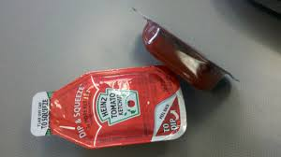
6 Essentials For Effective Product Packaging Design
1. Superb form and function

Slide 4
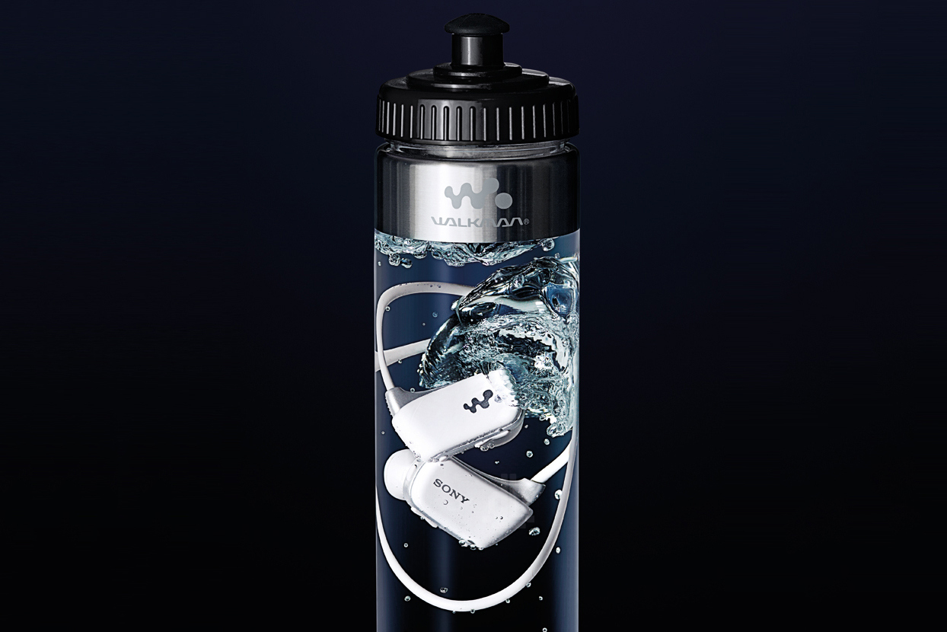
2. Maximum shelf impact

Slide 5
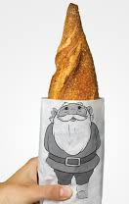
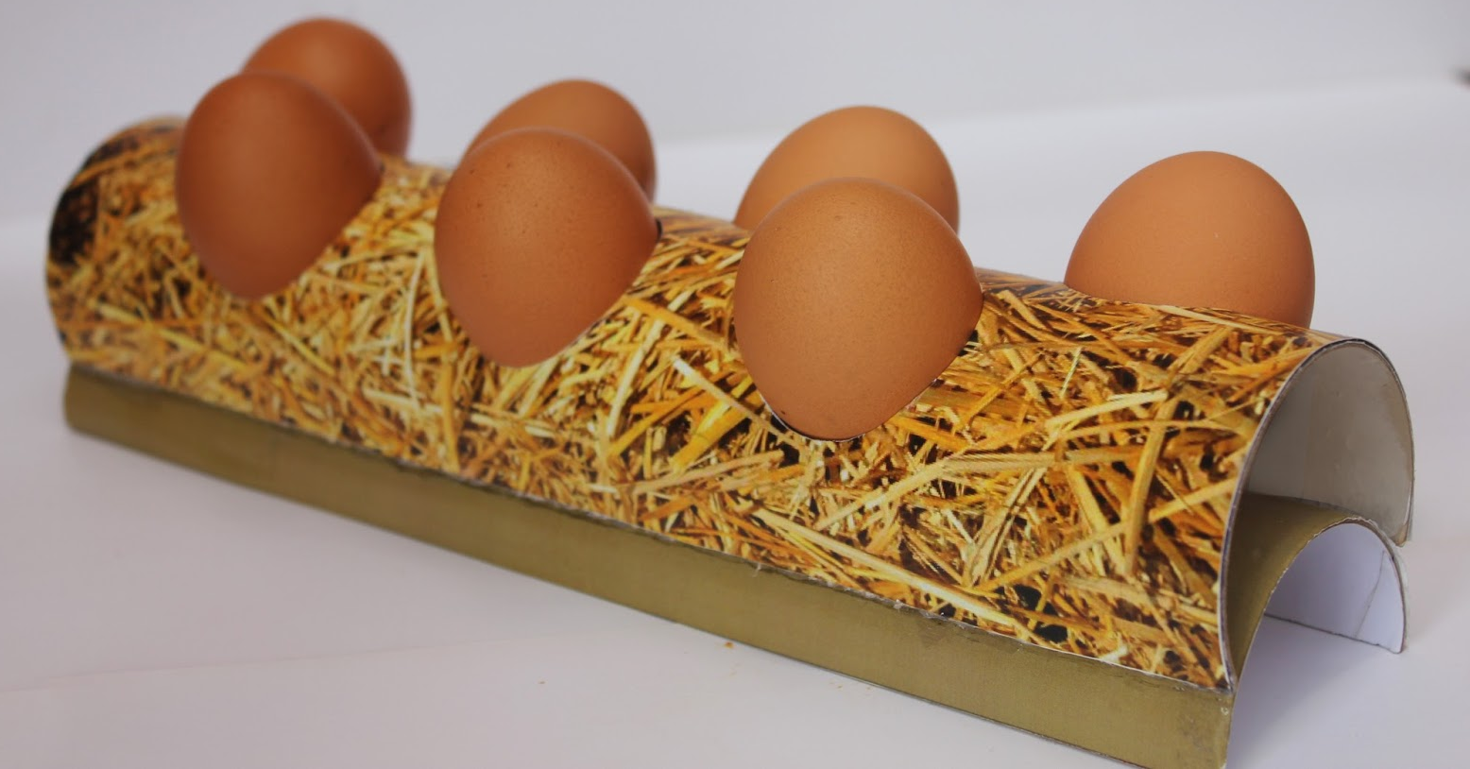
3. Honesty

Slide 6
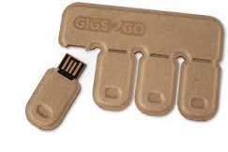
4. Practicality

Slide 7
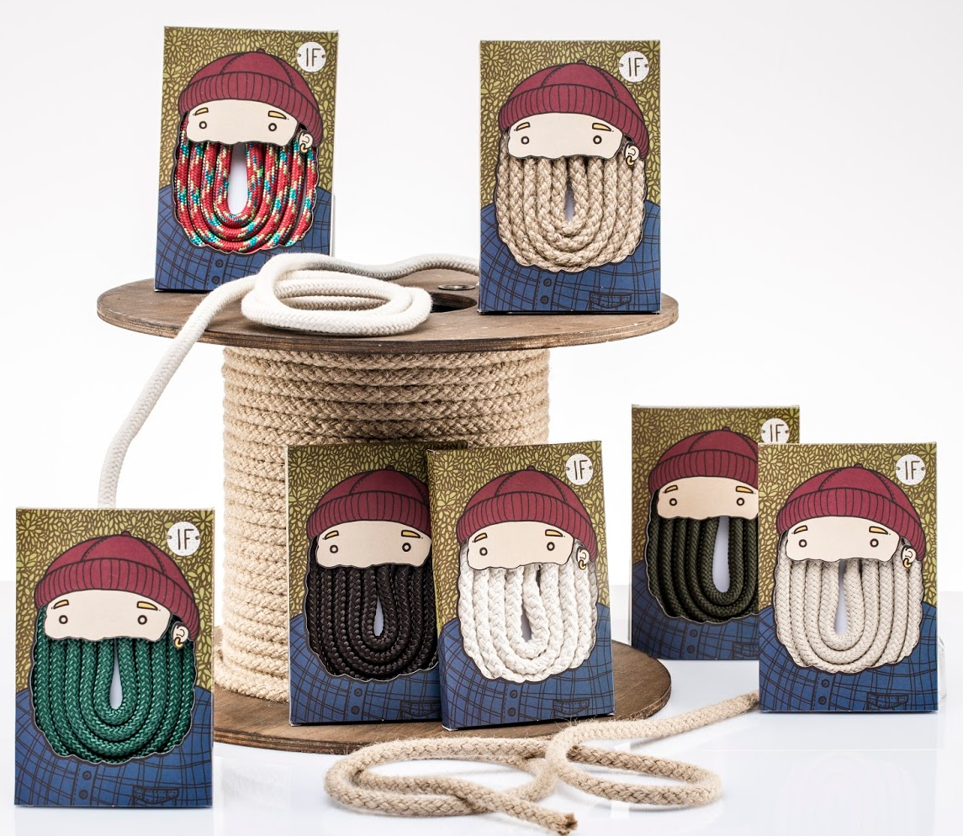
5. Originality and creativity

Slide 8
6. Go green

Slide 9
Plan of Attack for class
1.Start your exercise book
2. Create your package design.
3. 6:30 – 6:40 Break time
4. 7:40 Share your 3-2-1 and your advertisement

Slide 10
How to Send me your package Designs
First save your file to the desktop and export your package design
Reply to the e-mail I sent you and attach your package design.
Or
E-MAIL-preston.gillis777@gmail.com
Please remember to put your name on your worksheet in the email that you send me

